Slide 1
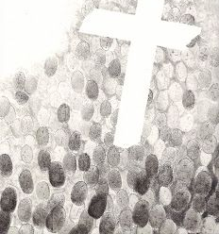
Autumn Term 2 2022
Saint a day
To support ‘Dates in the Diary’ of Staffroom/ Tutor Noticeboard.
To increase knowledge of Saints.

Slide 2
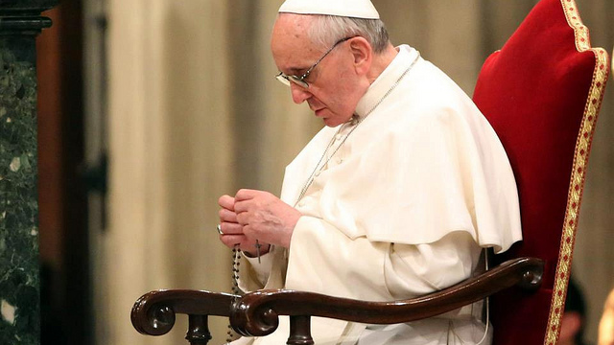
The Pope’s Prayer Intention for November
Children Who Suffer
We pray for children who are suffering, especially those who are homeless, orphans, and victims of war; may they be guaranteed access to education and the opportunity to experience family affection.

Slide 3
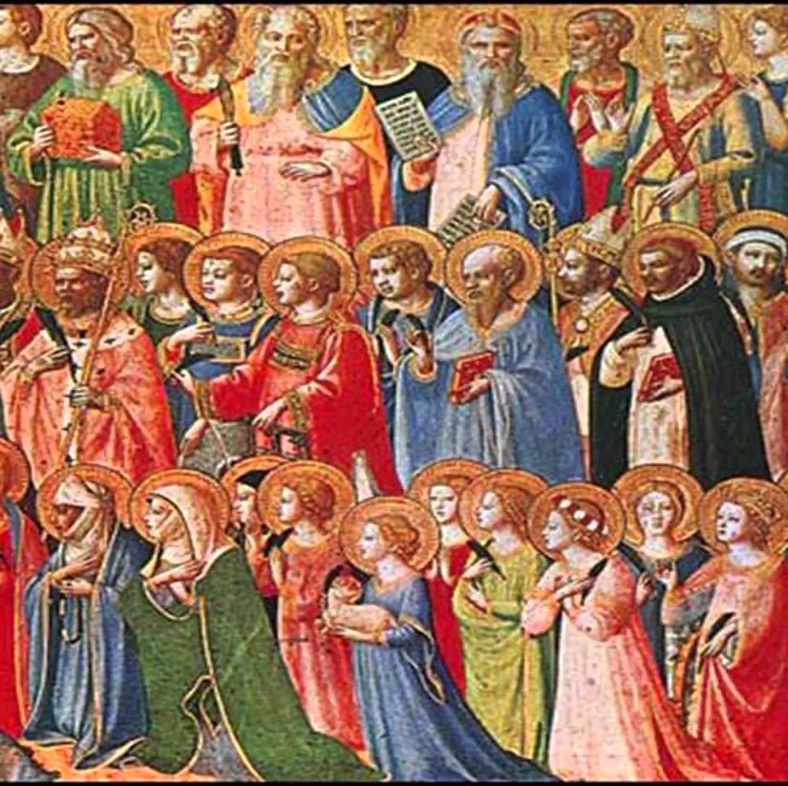
1st November All Saints Day
The day is dedicated to the saints of the Church, that is, all those who have attained heaven. It should not be confused with All Souls' Day, which is observed on November 2, and is dedicated to those who have died and not yet reached heaven.
All Saints' Day observances tend to focus on known saints --that is those recognised in the canon of the saints by the Catholic Church.

Slide 4
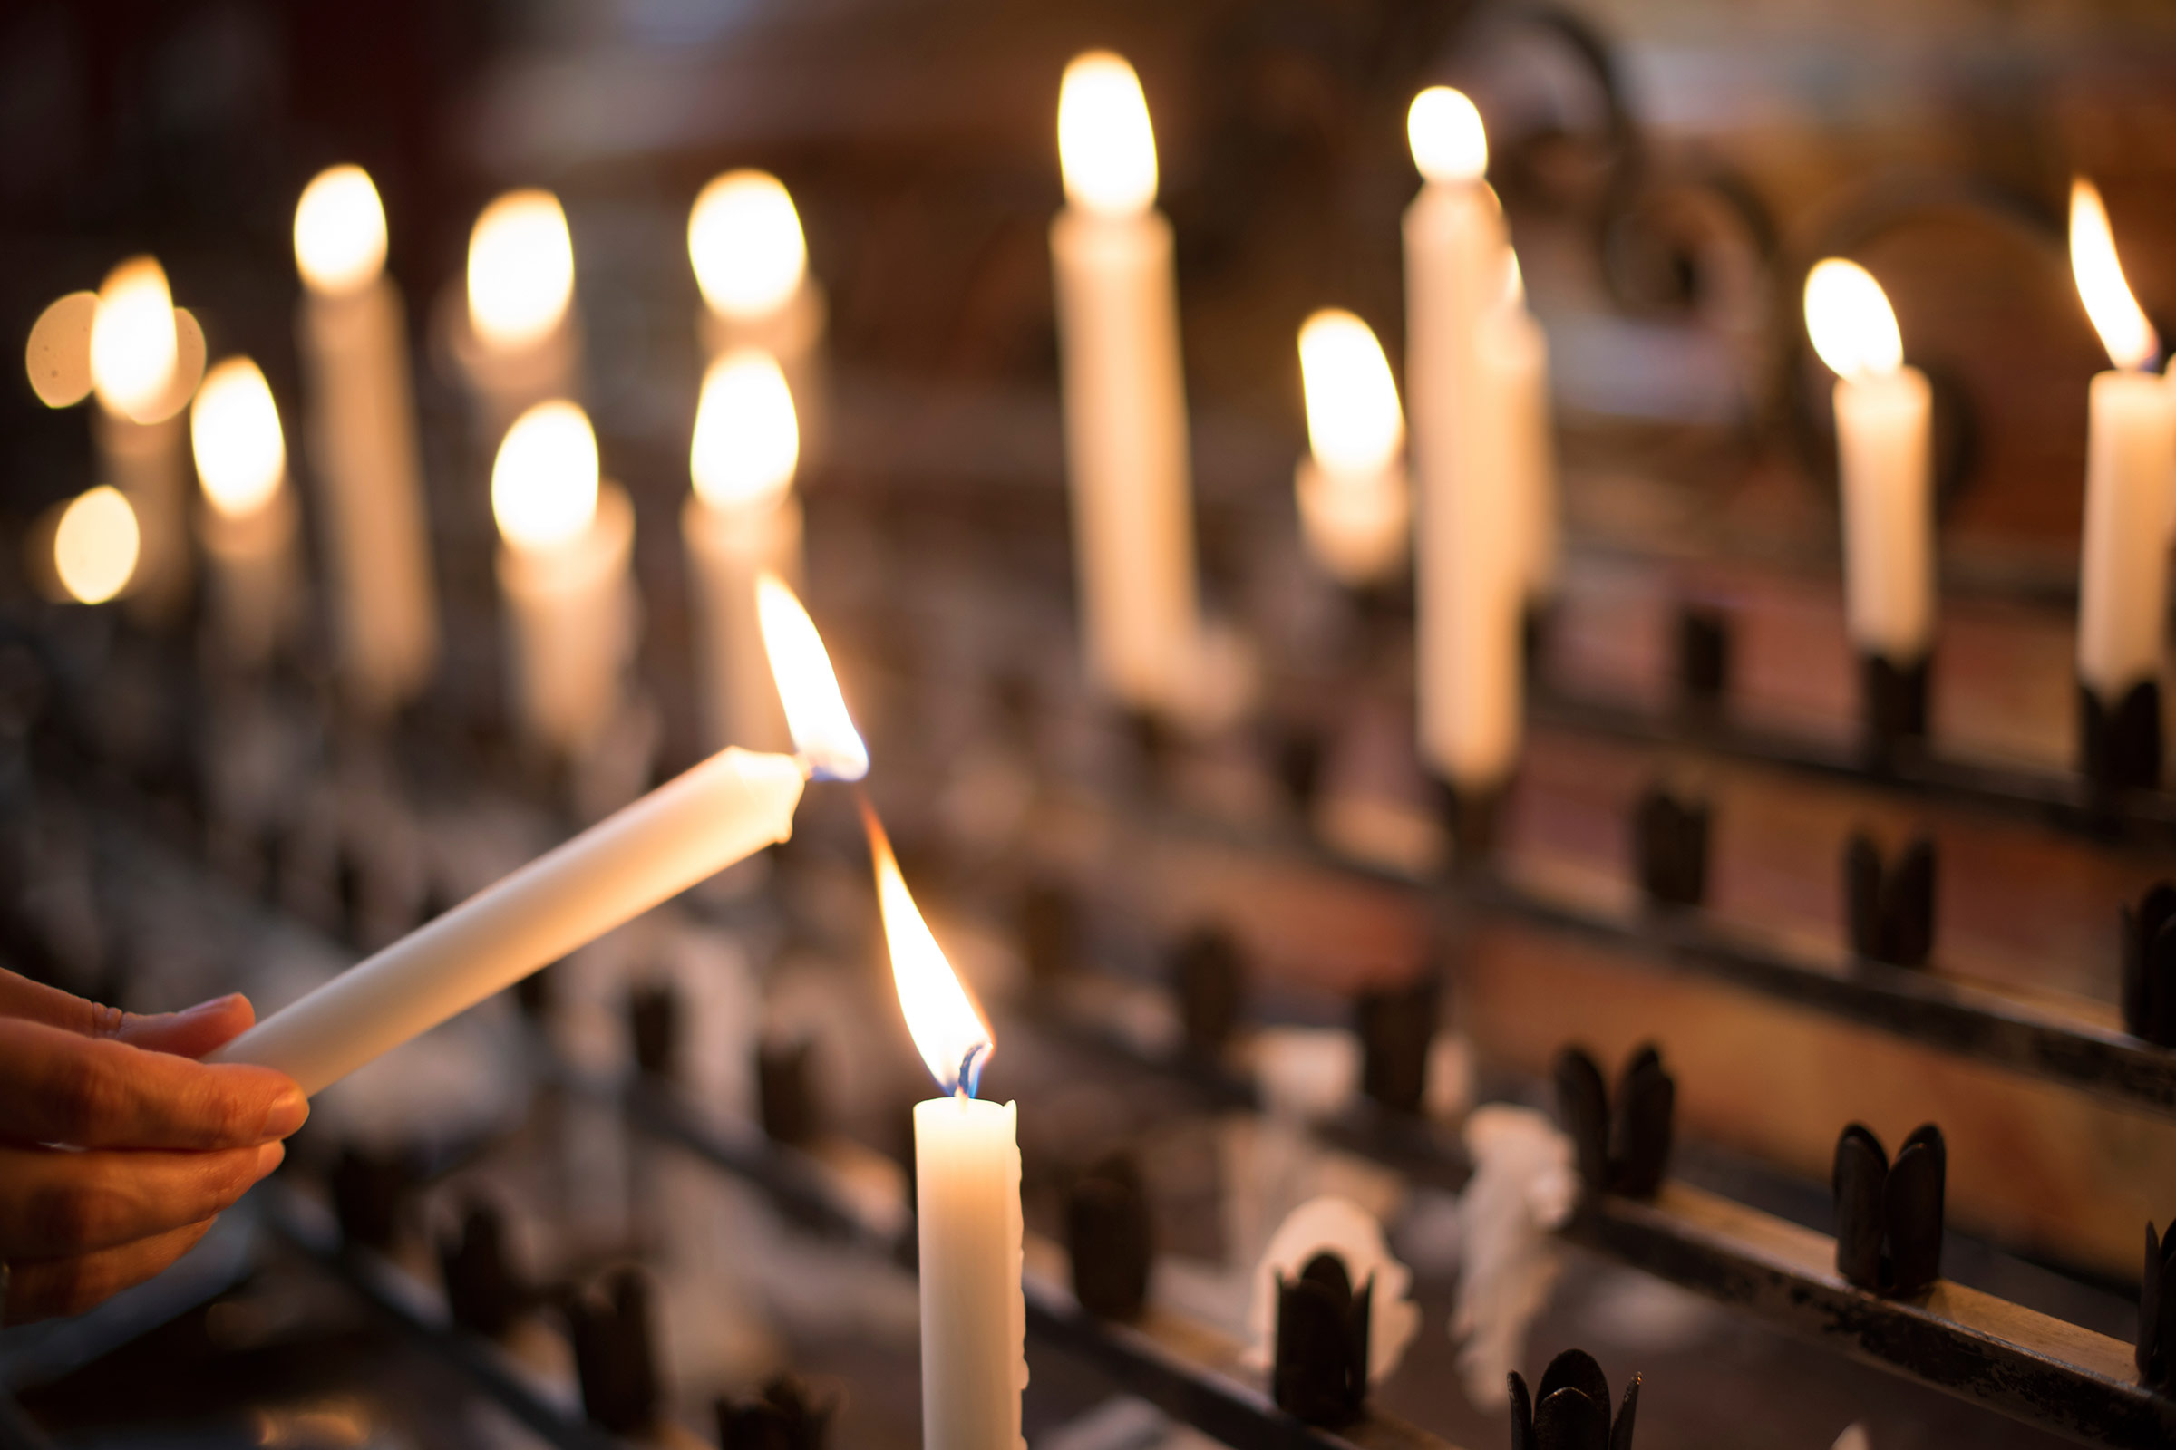
2nd November All Souls Day
Immortal God, heavenly Father and Protector
of all You have created, we raise our hearts to You today for those who have passed out of this mortal life. In Your loving mercy, Father of all,
be pleased to receive them in Your heavenly company, and forgive the failings and faults they may have done from human frailty. Your only Son, Christ, our Saviour, suffered so cruelly that He might deliver them from the second death. By his merits may they share in the glory of His victory over sin and death. For all the faithful who have died we pray, but in particular for those dear to us, parents, relatives and friends. nor do we forget all who did good to us while on earth, who helped us by their prayers, sacrifice and example. We pray also for any who may have done us harm, and stand in special need of Your forgiveness. May the merits and prayers of our Virgin Mother, Mary, and those of all the Angels and Saints, speak for us and assist them now. This we ask in Christ's name. Amen.
The Commemoration
of
All the Faithful Departed.

Slide 5
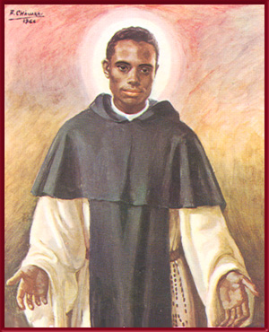
3rd November Memorial of St. Martin De Porres
St. Martin de Porres was born in Lima, Peru on December 9, 1579.
He experienced a great deal of ridicule for being of mixed-race.
When he was 15, he asked to join the Dominican Convent of the Rosary in Lima and helped by giving money to the poor.
Martin was the first mixed race person to be allowed to take his vows as a member of the Third Order of Saint Dominic. This was really important because at the time mixed race people were not allowed to join.
He was compassionate and loving to all and loved animals.
Martin also founded an orphanage for abandoned children and slaves.
He died when he was 60-years-old.
He is the patron saint of mixed race people, innkeepers, barbers, public and health workers.
St. Martin De Porres - Pray for us.

Slide 6
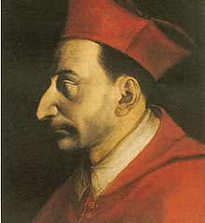
4th November Memorial of St. Charles Borromeo
St. Charles of Borromeo Born 1538, Died 1584.
Charles was part of a noble and prosperous family, his mother was the sister of Pope Pius IV.
He became a lawyer and was then appointed cardinal of Milan.
He founded colleges and hospitals, which he built with his vast wealth.
He humbly offered himself as a sacrifice for the people in order to minister the Sacraments to the dying; yet neither he nor any one of the twenty-eight voluntary priests who accompanied him caught the infection.
St. Charles said ‘Be sure that you first preach by the way you live’. And ‘Stay quiet with God’.
St. Charles Borromeo… Pray for Us.

Slide 7
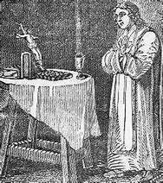
8th November Blessed George Napier
Born 1550 at Holywell Manor, Oxford, England
Died He was arrested and convicted of the crime of priesthood.
He is martyr of Oxford as he was hanged, drawn, and quartered between 1 and 2 in the afternoon of 9 November 1610 at Oxford, England.
Blessed George Napier…
Pray with us.

Slide 8
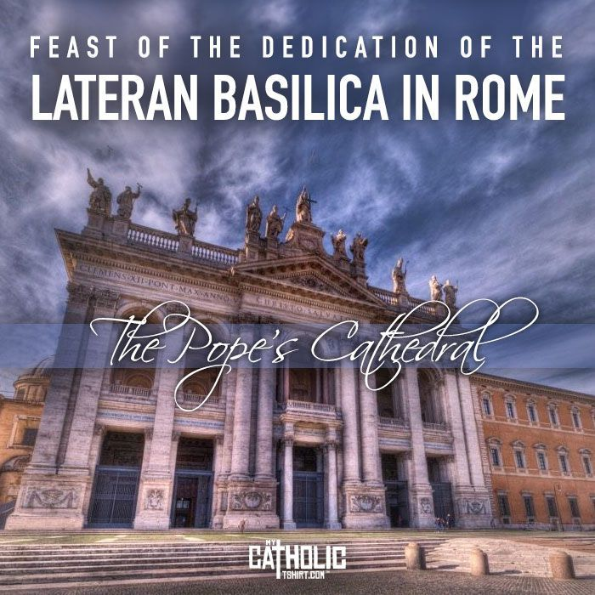
9th November Feast of the Dedication of Lateran Basilica
Most Catholics think of St. Peter’s as the pope’s main church, but they are not quite right.
St. John Lateran is the pope’s church, the cathedral of the Diocese of Rome where the Bishop of Rome presides.
The first basilica on the site was built in the fourth century when the Roman Emperor Constantine donated land he had received from the wealthy Lateran family.
That structure and its successors suffered fire, earthquake and the ravages of war, but the Lateran remained the church where popes were consecrated until the popes returned from Avignon in the 14th century to find the church and the adjoining palace in ruins.
Pope Innocent X commissioned the present structure in 1646. One of Rome’s most imposing churches, the Lateran’s towering facade is crowned with 15 colossal statues of Christ, John the Baptist, John the Evangelist and 12 doctors of the Church. Beneath its high altar rest the remains of the small wooden table on which tradition holds St. Peter himself celebrated Mass.

Slide 9
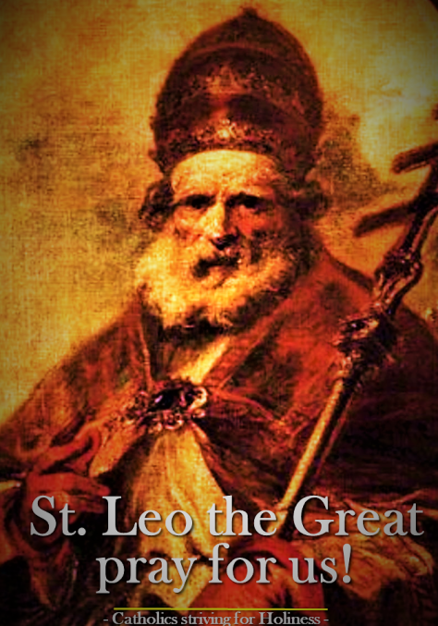
10th November Memorial of St. Leo the Great
Born: 400 AD
Died: 461 AD
Click the link to learn more about his life:
https://www.youtube.com/watch?v=aR71hhfxAaw&autoplay=1&list=PL58g24NgWPIzvBk2IQVES_xC4WTm6-CDI

Slide 10
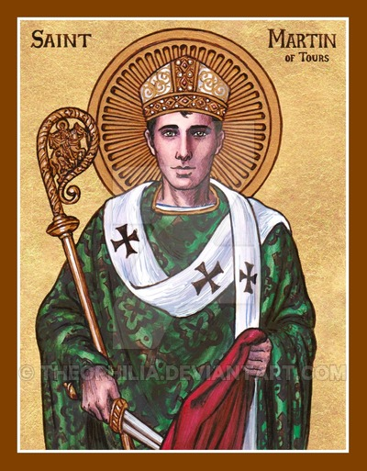
11th November St. Martin of Tours
From a young age Martin wanted to be baptised. His father was not happy with this so sent him away to join the army.
When stationed at Amiens (France), he met an almost naked man and Martin cut his cloak in half and gave half to the poor man.
That night, in a dream Martin saw Our Lord clothed in the half cloak, and heard Him say to the angels: "Martin has wrapped Me in his cloak."
He decided to be baptised, and shortly after he left the army.
He took shelter with St. Hilary, and founded the first monastery in France.
In 372 he was made Bishop of Tours.
Martin converted many people to be Catholics.
He is known as the Apostle of Gaul (France).
He died 383.

Slide 11
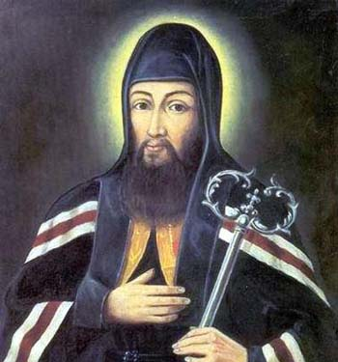
12th November St. Josaphat
Josaphat Kuntsevych was a Polish-Lithuanian monk and archbishop .
On 12 November 1623 he was killed by an angry mob in Vitebsk, in the Polish-Lithuanian Commonwealth (now in Belarus).
St. Josaphat’s favourite devotional exercise was to say, the Jesus prayer:
‘Lord Jesus Christ, Son of God, have mercy on me, a sinner.”
St. Josaphat - Pray for us.

Slide 12
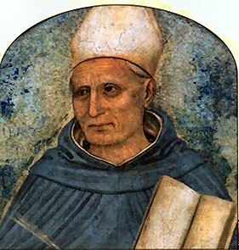
15th November St. Albert the Great
Click the link to learn about St. Albert the Great.
https://www.youtube.com/watch?v=Sjprd3f-760
St Albert the Great– Pray for us.

Slide 13
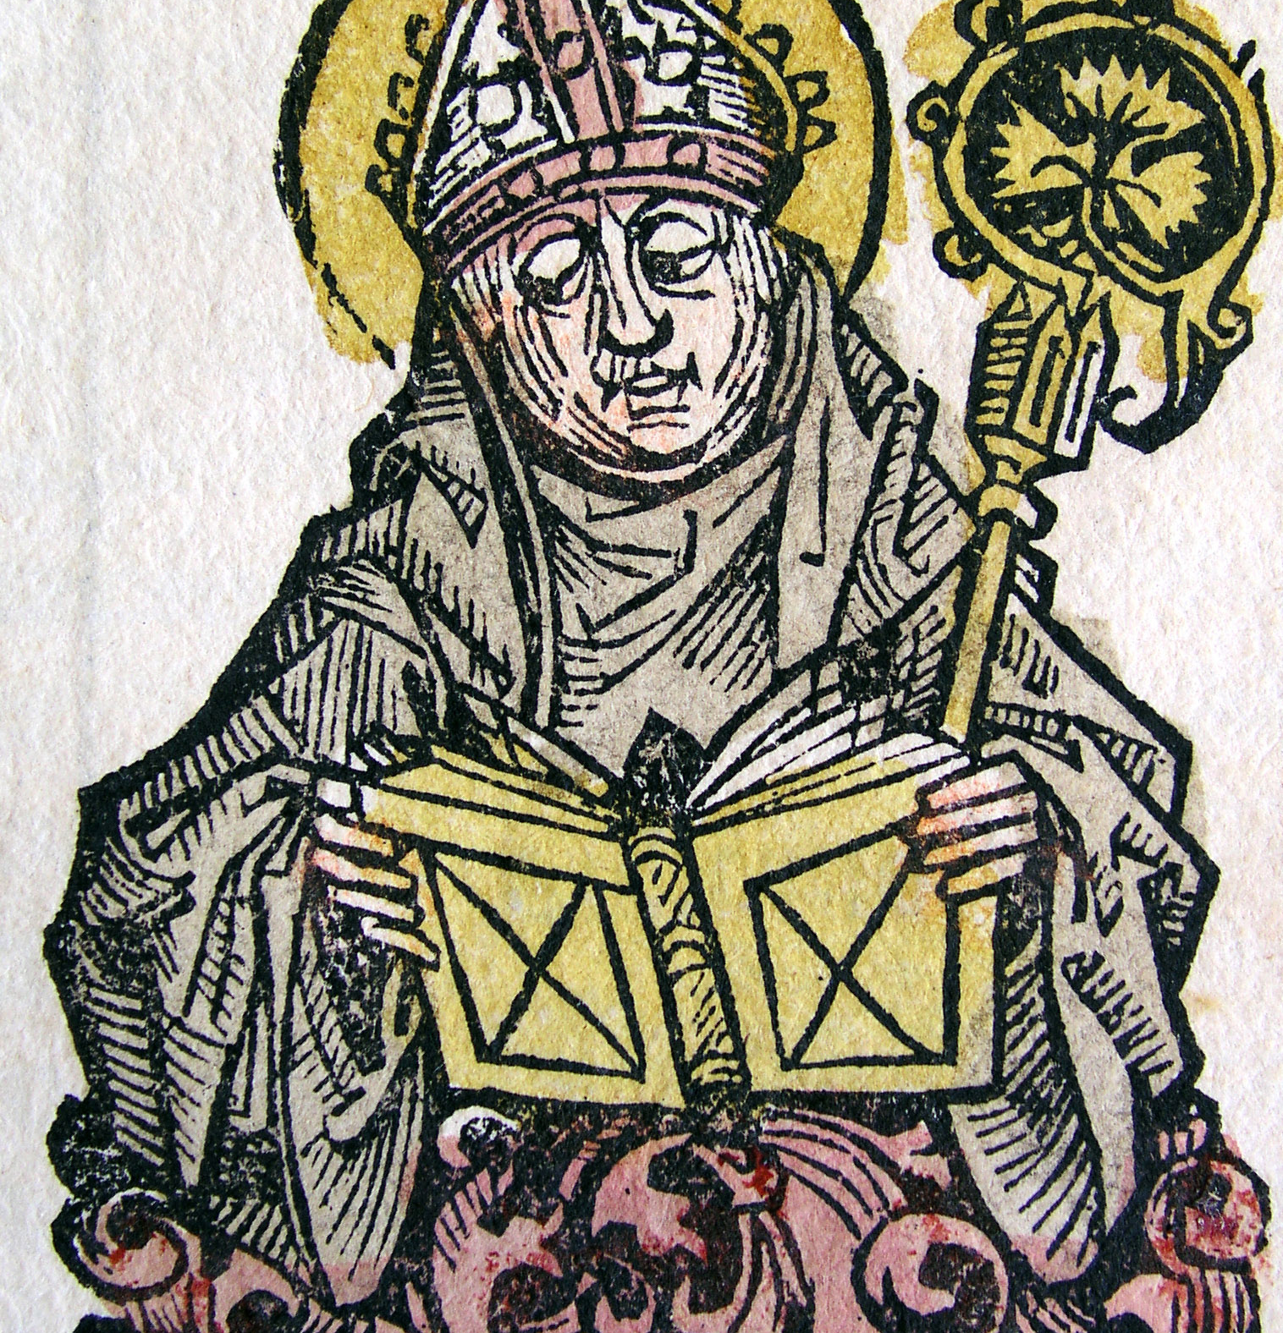
16th November Memorial of St. Edmund of Abingdon
He was the Archbishop of Canterbury England.
Born in Abingdon, on November 30, 1180. he studied at Oxford, England, and in Paris, France.
He taught art and mathematics at Oxford University and was ordained. He spent eight years teaching theology and became Canon and treasurer of Salisbury Cathedral.
He became an advisor to King Henry III in 1237. When Cardinal Olt became a papal legate with the patronage of King Henry, Edmund protested.
A long-lasting feud between Edmund, the king, and his legate led him to resigning as the Archbishop of Canterbury in 1240.
He went to Pontigny, France, where he became a Cistercian.
He died at Soissons (France), on November 16.
Edmund was made a saint in 1246 1247.
St. Edmund……Pray for us.

Slide 14
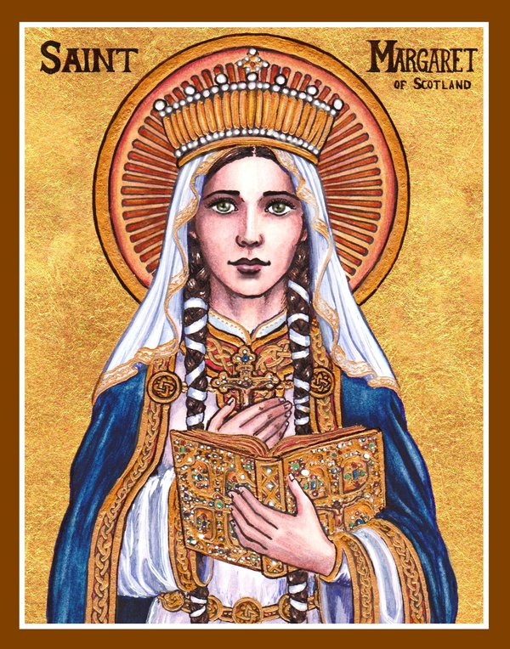
16th November
Memorial of St. Margaret of Scotland
Margaret married Malcolm Canmore III, the king of Scotland in 1070 at the castle of Dunfermline.
Her impact in Scotland led her to be referred to as, "The Pearl of Scotland."
She worked to help the poor and encouraged people to live a prayerful life, and grow in holiness. She helped to build many churches.
In 1093, Malcolm was killed in the Battle and Margaret passed away four days after her husband, on November 16, 1093.
In 1250, Pope Innocent IV canonized Margaret as a Saint, acknowledging her life of holiness and extraordinary virtue.
She was honoured for her work for reform of the Church and her personal holiness.
St. Margaret is the patron saint of Scotland.
Click the link below to learn more:
https://www.youtube.com/watch?v=eefjZY2L9LI&autoplay=1&list=PL58g24NgWPIzvBk2IQVES_xC4WTm6-CDI

Slide 15
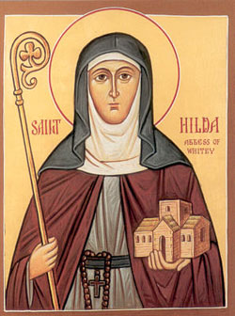
17th November
Memorial of St. Hilda
(614 - 680)
Benedictine abbess, baptized by St. Paulinus. She was the daughter of a king of Northumbria, England.
She is considered one of England's greatest women.
At thirty three years old Hilda entered Chelles Monastery in France, where her sister was also a nun.
At the request of St. Aidan, she returned to England and became abbess of Hartlepool.
In time she became the head of the monastery of Streaneschalch, at Whitby in North Yorkshire.
St. Hilda…Pray for us.

Slide 16
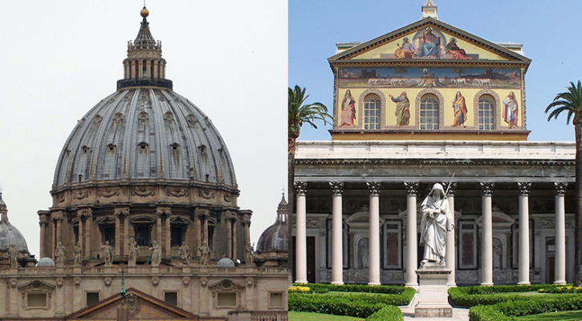
18th November Memorial of the Dedication of the Basilica of Ss Pater & Paul
St. Peter’s is probably the most famous church in Christendom. Massive in scale and a veritable museum of art and architecture, it began on a much humbler scale. Vatican Hill was a simple cemetery where believers gathered at Saint Peter’s tomb to pray.
In 319, Constantine built a basilica on the site that stood for more than a thousand years until, despite numerous restorations, it threatened to collapse. In 1506, Pope Julius II ordered it razed and reconstructed, but the new basilica was not completed and dedicated for more than two centuries.
St. Paul’s Outside-the-Walls stands near the Abaazia delle Tre Fontane, where Saint Paul is believed to have been beheaded. The largest church in Rome until St. Peter’s was rebuilt, the basilica also rises over the traditional site of its namesake’s grave.
The most recent edifice was constructed after a fire in 1823. The first basilica was also Constantine’s doing.
At intervals of five years, every diocesan bishop in the Catholic Church is obligated to make a visit “ad limina apostolorum”—“to the threshold (of the tombs) of the apostles.” This means they pray at the tombs of Saints Peter and Paul in Rome and personally report to Saint Peter’s successor Pope Francis.
Let us pray…
Holy martyrs Peter and Paul, your tombs are the sacred destinations of many pilgrimages to the eternal city. May all visits to the Basilicas dedicated to your honour deepen one’s love and commitment to Mother Church.
Amen

Slide 17
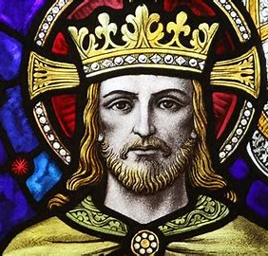
Sunday 20th Solemnity of Our Lord Jesus Christ, King of the Universe (National Youth Sunday)
This Liturgical year began on the First Sunday of Advent, and it ends today with the Feast of Christ the King.
During the Liturgical year, we re-live the life of Christ and try to immerse ourselves in the kingdom he came to establish.
We reflect on the question:
"Is Christ more king of my life now than a year ago?"

Slide 18
21st November Memorial of the Presentation of the Blessed Virgin Mary
This Ancient feast is held in high esteem by Eastern Christianity. It celebrated Our Lady’s dedication to God, which prepared her for her acceptance of God’s will that she became the Mother of His Son.
The celebration of this feast dates back to the 6th century in the East with the dedication of the Basilica of Saint Mary the New built by the Emperor Justinian I near the ruins of the temple in Jerusalem.
There is evidence that various monasteries in Italy celebrated the feast in the 9th century. It was not until the 15th century that it was included in the Roman Missal.
Every Christian is called to look at Mary so as to learn from her, to entrust themselves to her intercession and to guard the “purity of the faith” against any idols that surround us.

Slide 19
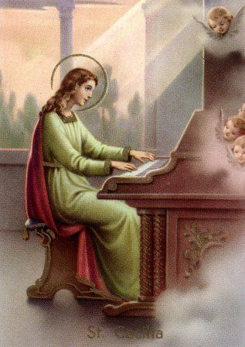
22nd November St. Cecilia
Saint Cecilia is the patron saint of musicians and Church music because when she was dying she sang to God.
St. Cecilia was an only child.
At an early age, Cecilia dedicated her life to god with a vow of Chasity. Cecilia was deeply in love with god since she was a child.
St. Cecilia – Pray for Us

Slide 20
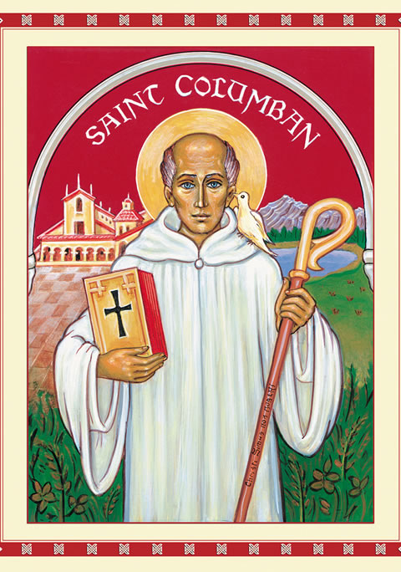
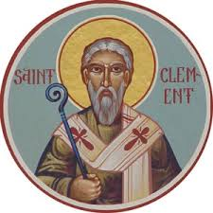
23rd November
Memorial of St. Clement
Memorial of St. Columban
Little is known of this apostolic father beyond a few facts. He was a disciple of St. Peter, and perhaps of S. Paul.
It is thought that St. Paul praises as a faithful fellow- worker, whose name is written in the Book of Life [Philippians 4:3].
He was afterwards bishop of Rome.
He is the patron saint of metalworkers and blacksmiths, and so these workers traditionally enjoyed a holiday on his feast day.
Born: 559- Died: 615
Columban was a native Ireland.
Columban aged thirty, left Ireland with twelve other monks, crossed Great Britain, and reached Gaul (France).
He set up a new monastery.
He passed the remainder of his days in prayer, visiting his monastery only on Sundays and festivals.
He died on November 21, 615, when over seventy-two years old.
He was buried at Bobbio.
He is referred to as one of the greatest missionaries of the Celtic church, who initiated a revival of spirituality on the European continent.
St. Clement and St. Columban… Pray for us.

Slide 21
24th November Memorial of St. Andrew Dung-Lac
Vietnamese martyr, companion of St. Peter Thi.
Andrew, born in 1785, was a priest in Vietnam, his homeland.
He was arrested and beheaded on December 21 with Peter Thi.
He was canonized in 1988 by Pope John Paul II.
Learn more about his life:
https://www.youtube.com/watch?v=5OGYfJUfhs0

Slide 22
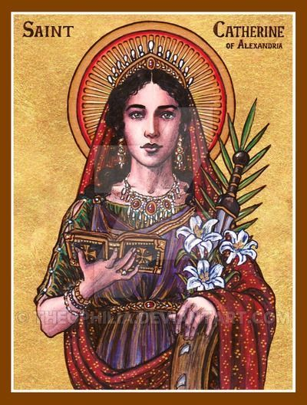
Monday 25th St. Catherine of Alexandria
The young saint was born around 287 in Alexandria, Egypt. At that time, Alexandria was one of the finest cities in the world, and a centre of learning and culture as well as faith.
Although she was a teenager, she was very intelligent and gifted.
The emperor angrily ordered her to be executed on a breaking wheel.
The spiked wheel is a popular symbol often associated with St. Catherine.
She is the patron saint for students and unmarried females.
Click blow to learn more about her life:
https://www.catholic.org/saints/saint.php?saint_id=341

Slide 23
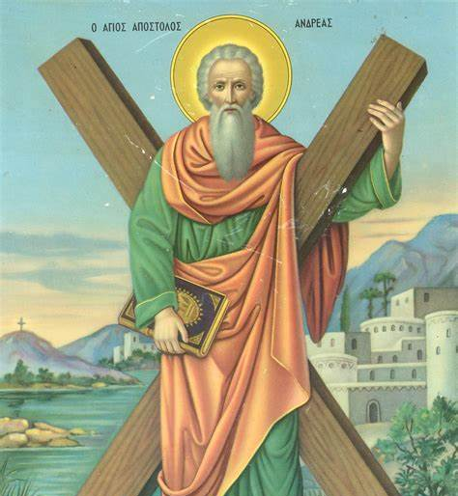
30th November St. Andrew
Saint Andrew, was an apostle of Jesus according to the New Testament. He is the brother of Saint Peter. He is referred to in the Orthodox tradition as the First-Called.
A tradition developed that Andrew had been crucified on a cross of the form called crux decussata (X-shaped cross, or "saltire"), now commonly known as a "Saint Andrew's Cross" — supposedly at his own request, as he deemed himself unworthy to be crucified on the same type of cross as Jesus had been.
He is the Patron Saint of Scotland.
St. Andrew…. Pray for us.

Slide 24
The Pope’s Prayer Intention for December
Volunteer Not-for-profit Organisations
We pray that volunteer non-profit organisations committed to human development find people dedicated to the common good and ceaselessly seek out new paths to international cooperation.

Slide 25
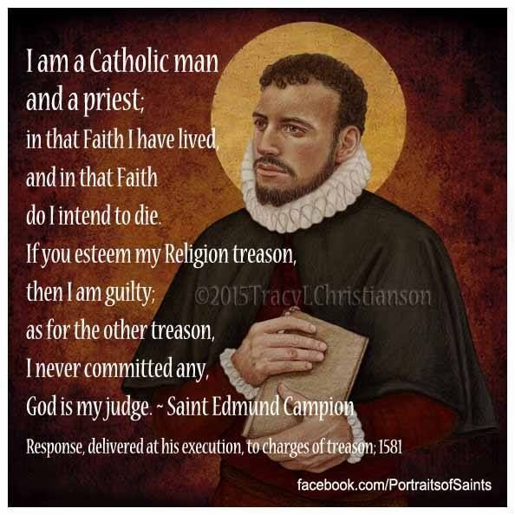
1st December 1st December Feast of St. Edmund Campion
Edmund was born in London, the son of a bookseller. He was raised a Catholic, given a scholarship to St. John's College, Oxford, when fifteen, and became a fellow when only seventeen.
He took the Oath of Supremacy acknowledging Elizabeth head of the church in England and became an Anglican deacon in 1564.
Doubts about Protestanism increasingly worried him, and in 1569 he went to Ireland where further study convinced him he had made a mistake, and he returned to Catholicism.
He and Father Robert Persons were the first Jesuits chosen for the English mission and were sent to England in 1580.
He was betrayed at Lyford, near Oxford, imprisoned in the Tower of London.
He was tortured and then hanged, drawn, and quartered at Tyburn on December 1.
24 Jan 1540 - 01 Dec 1581

Slide 26
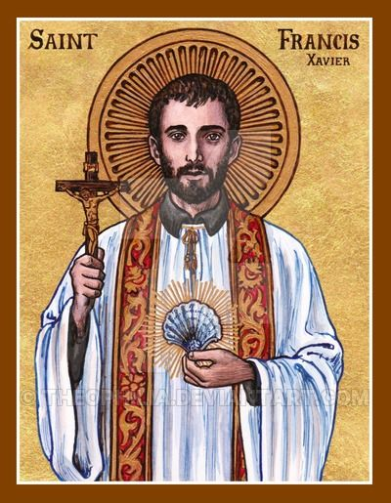
3rd December St. Frances Xavier
St. Francis Xavier was a Navarrese-Basque Roman Catholic missionary born in the Kingdom of Navarre on April 7, 1506.
On August 15, 1534, Francis Xavier along with Peter Favre, and several other friends, made vows of poverty, chastity, and obedience. The men planned to travel to the Holy Land to convert non-believers. Francis Xavier started his study of theology that same year and was ordained on June 24, 1537.
Pope Paul III approved the formation of their order in 1540, which became The Society of Jesus. The order is more popularly became known as the Jesuits.
He is the patron of Catholic missions.
Click the link below to view a clip on who St Francis Xavier was…
https://www.youtube.com/watch?list=PL58g24NgWPIzvBk2IQVES_xC4WTm6-CDI&time_continue=4&v=oGmWesRGLzQ

Slide 27
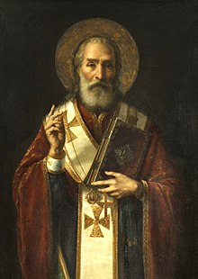
6th December Memorial of St. Nicholas
Saint Nicholas (15 March 270 – 6 December 343), also known as Nicholas of Bari, was an early Christian bishop of Greek descent from the maritime city of Myra in Asia Minor during the time of the Roman Empire.
Because of the many miracles attributed to his intercession, he is also known as Nicholas the Wonderworker.
One story about St. Nicholas is that he visited the Holy Land. The ship he was on was nearly destroyed by a terrible storm, but he rebuked the waves, causing the storm to subside. Because of this miracle, Nicholas became venerated as the patron saint of sailors and travellers.
Saint Nicholas is the patron saint of sailors, merchants, archers, repentant thieves, children and students in various cities and countries around Europe.
St. Nicholas. Pray for us.

Slide 28
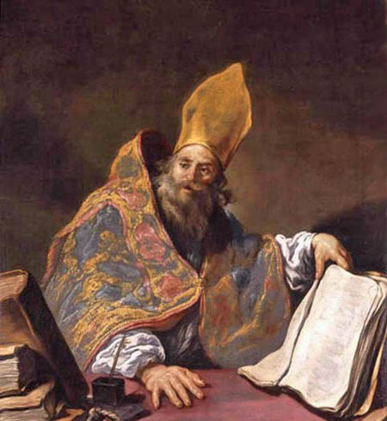
7th December St. Ambrose, Doctor of the Church.
Saint Ambrose, also known as Aurelius Ambrosius, is one of the four original doctors of the Church. He was the Bishop of Milan and became one of the most important theological figure of the 4th century.
He is the patron saint of bee keepers, beggars and learning.
St. Ambrose…. Pray for us….

Slide 29
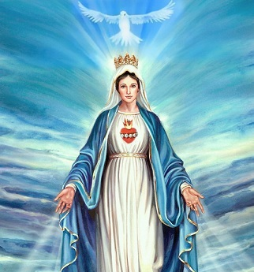
8th December Immaculate Conception of the Blessed Virgin Mary
Patroness of the Archdiocese Of Birmingham.
The Immaculate Conception, according to the teaching of the Catholic Church, is the conception of the Blessed Virgin Mary free from original sin by virtue of the foreseen merits of her son Jesus Christ.
Immaculate Mary… Pray for us….

Slide 30
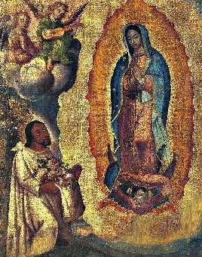
9th December St. John Diego Cuauhtlatoatzin
Saint Juan Diego was born in 1474 as Cuauhtlatoatzin, a native to Mexico.
He became the first Roman Catholic indigenous saint from the Americas.
He was recognized for his religious fervour, his respectful and gracious attitude toward the Virgin Mary and his Bishop Juan de Zumarraga, and his undying love for his ill uncle.
Birth: 1474 Death: 1548 Beatified:
May 6, 1990 by Pope John Paul II Canonized:
July 31, 2002 by Pope John Paul II
Learn more about his life:
https://www.youtube.com/watch?v=--IRbuAu2XQ&autoplay=1&list=PL58g24NgWPIzvBk2IQVES_xC4WTm6-CDI

Slide 31
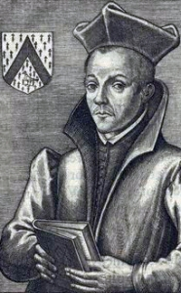
10th December Memorial in Staffordshire of St. Edmund Ginnings
Edmund was born at Lichfield in 1567.
At the age of 14yrs he to the English College at Rheims where he was ordained a priest at Soissons in 1590, being then only twenty-three years of age. He immediately returned to the dangers of England under the assumed name of "Ironmonger".
One of the greatest English saints, a monk and bishop who was outstanding in bringing about close relations between the Anglo-Saxon Church and the Pope.
Ginnings returned to London in 1591. His missionary career was brief. He was arrested by Richard Topcliffe whilst in the act of saying Mass.
He was hanged, drawn and quartered outside the same house on 10 December.
Edmund Ginnings was canonized as one of the Forty Martyrs of England and Wales by Pope Paul VI on 25 October 1970.
A Catholic Mass centre opened in 1967 in the New Invention area of Willenhall, West Midlands. It was later upgraded to a church and was dedicated to Edmund Ginnings.
St. Edmund Ginnings…Pray for us.

Slide 32
12th December Memorial of Our Lady of Guadlupe
The Blessed Virgin Mary appeared Saint Juan Diego 9th of December.
He became the first Roman Catholic indigenous saint from the Americas.
He was recognized for his religious fervour, his respectful and gracious attitude toward the Virgin Mary and his Bishop Juan de Zumarraga, and his undying love for his ill uncle.
Learn more about his life:
https://www.youtube.com/watch?v=--IRbuAu2XQ&autoplay=1&list=PL58g24NgWPIzvBk2IQVES_xC4WTm6-CDI

Slide 33
13th December St. Lucy Lucia of Syracuse (283–304), also known as Saint Lucy Patron Saint of authors, cutlers, glaziers, laborers and the blind. Click the link below to find out more: https://www.youtube.com/watch?list=PL58g24NgWPIzvBk2IQVES_xC4WTm6-CDI&time_continue=1&v=EyOgawktWOE

Slide 34
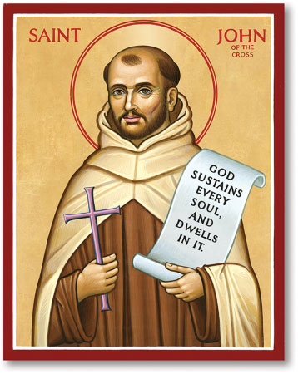
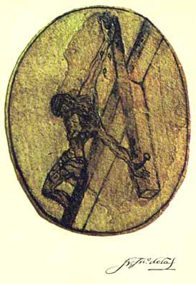
14th December St John of the Cross
Saint John of the Cross was born in Avila, Spain in 1542.
John became a priest in 1567, he encountered Theresa of Avila and followed her ways..
He had a vision of Christ and made a drawing that remains to this day called, "Christ from Above.“
He is the patron of Contemplatives, mystics and Spanish poets.
Click below to find out more:
https://youtu.be/UcwsL7yQiy4?list=PL58g24NgWPIzvBk2IQVES_xC4WTm6-CDI

