Slide 1
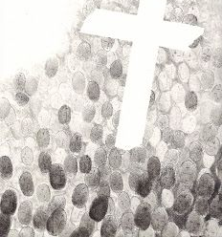
Spring Term 1 2023
Saint a day
To support ‘Dates in the Diary’ of Staffroom Noticeboard.
To increase knowledge of Saints.

Slide 2
Pope’s Prayer Intention January 2023
For educators:
We pray that educators may be credible witnesses, teaching fraternity rather than competition and helping the youngest and most vulnerable above all.

Slide 3
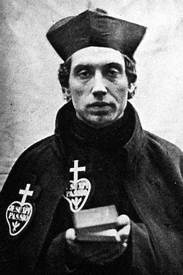
5th January St. Charles of St Andrew
St. Charles John Houben (1821-1893), was a Dutch Passionist priest who served firstly in Staffordshire and then in Mount Argus, Dublin, Ireland in the late 19th-century.
He showed extraordinary compassion for the sick and those in need of guidance.
He was canonised in 2007.
Heavenly Father, you filled Blessed Charles
with your Holy Spirit.
In the love of Christ he spent his life in prayer at the foot of the cross. Through the intercession of Blessed Charles give us the graces we need. Heal our aches and pains, our hurts and wounds, our anxieties and bad memories. Strengthen our faith, deepen our hope, and increase our love.
We make our prayer through Christ our Lord.
Amen

Slide 4
6th January Solemnity of the Epiphany of the Lord
The young Messiah is revealed as the light of the nations.
The adoration of the Christ Child by the Magi.
Epiphany means manifestation.
The Church celebrates today the manifestation of our Lord to the whole world; after being made known to the shepherds of Bethlehem.
He is revealed to the Magi who have come from the East to adore Him.
Christian tradition see in the Magi the first fruits of the non-believers becoming believers in Christ; they lead all the peoples of the earth, and so the Epiphany is an affirmation of universal salvation.

Slide 5
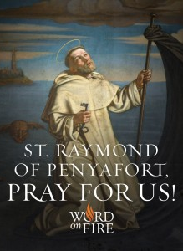
7th January St. Raymond of Penyafort
Born in Spain (1175), St. Raymond was a relative of the King of Aragon.
From childhood he had a tender love and devotion to the Blessed Mother.
He finished his studies at an early age, and became a famous teacher. He then gave up all his honours and entered the Order of the Dominicans.
He founded the Order of Our Lady of Ransom.
There is the story that he used his cloak as a sail to escape from King James of Aragon.
St. Raymond was one hundred years old at the time of his death.
He is the patron saint of canon lawyers.
‘As you drink the cup of the Lord Jesus (how glorious it is!), give thanks to the Lord, the giver of all blessings.’

Slide 6
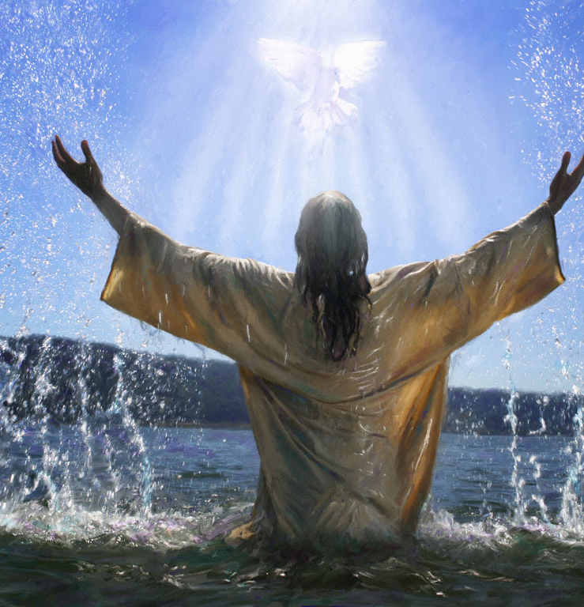
Sunday 8th January Feast of the Baptism of our Lord
This brings to a close the season of Christmas.
The Church recalls Our Lord's second manifestation or epiphany which occurred on the occasion of His baptism in the Jordan. Jesus descended into the River to sanctify its waters and to give them the power to create sons of God.
The event takes on the importance of a second creation in which the entire Trinity intervenes.

Slide 7
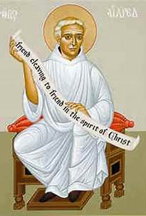
12thJanuary St. Aelred of Rievaulx
Aelred of Rievaulx (1110 – 12 January 1167) was an English Cistercian monk.
He became abbot of Rievaulx in Yorkshire from 1147 until his death.
His writings are considered among the finest produced in England during the Middle Ages.
‘The reward of friendship is itself. The man who hopes for anything else does not understand what true friendship is.’
St. Aelred…Pray for us

Slide 8
13th January Memorial of St. Hilary
St. Hilary was born in Poitiers, a town in southwest France, in 315.
He was brought up in an upper-class, non-Christian family.
He was fluent in both Latin and Greek.
He was married as a young man, and had a daughter named Apra.
He started to read the bible and became fascinated with the prologue to the Gospel of John (Jn 1:1-18), which led to his conversion and baptism in 350.
Three years later, in 353, Hilary was elected bishop of Poitiers
Hilary died at the age of 53.
St. Augustine called him “the illustrious doctor of the churches,” and in 1851 Pope Pius IX declared Hilary a Doctor of the Church.
St. Hilary… Pray for us.

Slide 9
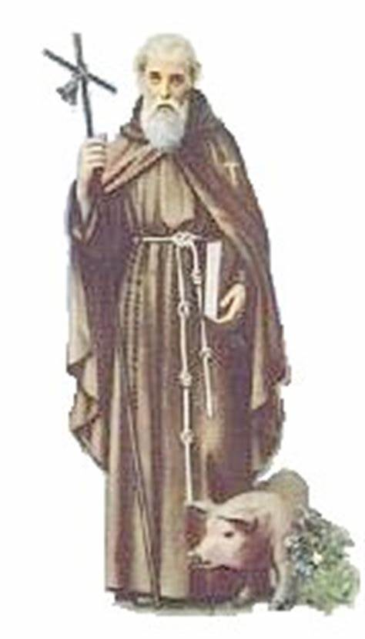
17th January Memorial of St. Anthony, Abbot
Saint Anthony the Abbot, was born at Qumans, a village on the left bank of the Nile, approximately 251 AD, and died in the Thebaid Desert in 357.
We know his life fairly well, thanks to the biography written by his disciple Athanasius.
Though he belonged to a rather wealthy family, from an early age he showed little interest in the flattery and luxury of worldly life: to parties and banquets he preferred work and meditation, and on the death of his parents he distributed all his wealth to the poor.
He chose to live as a hermit and retired into solitude, to work and pray, at first near his hometown and later in the desert.
St. Anthony…
Pray for us.

Slide 10
18th January Octave of Christian Unity Peace Day (The Octave 18th to the 25th January)
Materials for the Week of Prayer for Christian Unity 2022 have been prepared by the churches of the Middle East
The theme that was chosen, “We Saw His Star in the East… Serving the Gospel today requires a commitment to the human being, especially the poorest, the weakest and those marginalised. It requires from the churches transparency and accountability in dealing with the world, and with each other. This means churches need to cooperate to provide relief to the afflicted, to welcome the displaced, to relieve the burdened, and to build a just and honest society. This is a call for churches to work together so that young people can build a good future according to God’s heart, a future in which all human beings can experience life, peace, justice, and love.
Follow the link below to access all the resouces for the week.:
WPCU-2022-English-A5-1.pdf (ctbi.org.uk)

Slide 11
19th January Feast of St. Wulstan
St Wulstan (1008-1095) was born in Warwickshire, England.
He studied at the abbeys of Evesham and Peterborough, received ordination, and joined the Benedictines at Worcester.
St Wulstan served as treasurer of the church at Worcester, and finally was named bishop of Worcester in 1062.
After overcoming initial doubts about his ability to hold the office of bishop, he demonstrated such skill after the Norman Conquest that he was the lone bishop to be kept in his post by William the Conqueror (r. l066-l087).
For the next three decades, St Wulstan rebuilt his cathedral and cared for the sick and the poor.
He was canonised in 1203.
St. Wulstan… Pray for us.

Slide 12
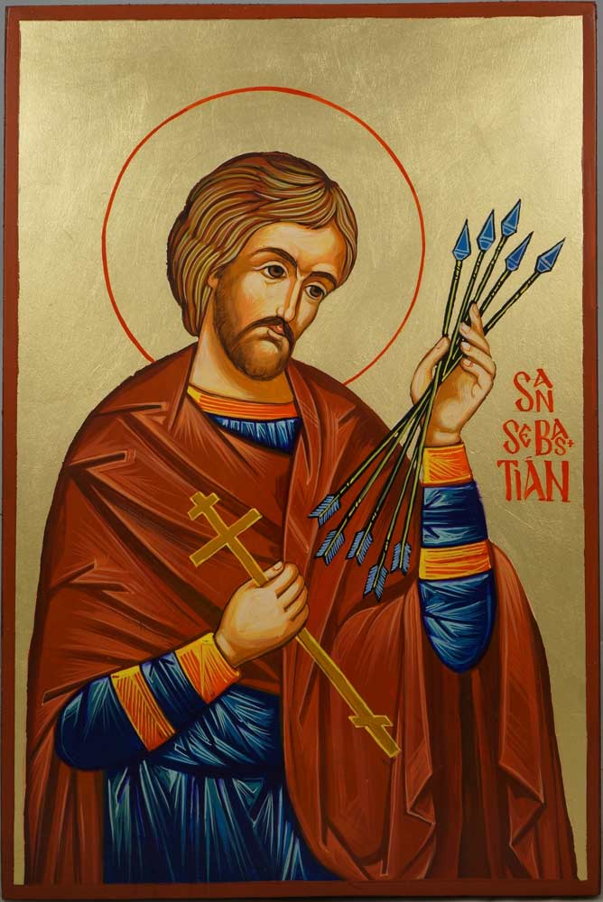
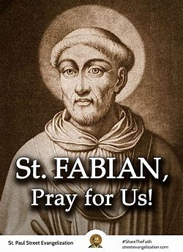
20th January Memorial
St. Sebastian, Martyr
St. Fabian, Martyr
Little is known about St. Sebastian's early life.
We know he joined the Roman army in 283 AD to infiltrate and convert and protect Christians.
When the emperor found out about him he had his soldiers kill him by bow and arrow.
They left him to die, but he survived by the help of St Irene of Rome.
He was later recaptured by the Emperor, beaten to death and thrown into the river.
He is the patron Saint of soldiers and athletes.
Saint Fabian, (died Jan. 20, 250, Rome;).
He was the pope from 236 to 250.
Fabian was an outstanding administrator and one of the great popes of the early church.
He divided Rome into seven districts assigned to the seven deacons and is said to have founded several churches in France.
His appointment of lawyers to register the actions of the martyrs reflected the increasing precision with which the Roman Catholic church began to keep records during his time.
Martyred during the persecution of the Roman emperor Decius, he was buried in the catacomb of St. Calixtus; his body was later moved to St. Sebastian’s, where his tomb was found in 1915.
Click the link below for more information.
https://www.youtube.com/watch?v=dsSGaclPeEk&autoplay=1&list=PL58g24NgWPIzvBk2IQVES_xC4WTm6-CDI
Click the link to learn more about St Sabastian.
https://www.youtube.com/watch?v=iJqSBRcB0Uk&autoplay=1&list=PL58g24NgWPIzvBk2IQVES_xC4WTm6-CDI
St. Sabastian– Pray for us.
St. Fabian– Pray for us.

Slide 13
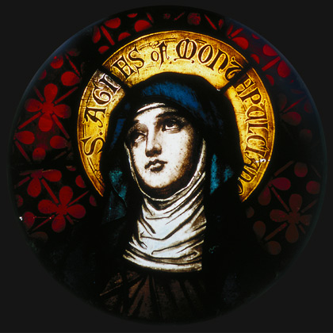
21st January Memorial of St. Agnes, Virgin, Martyr
St. Agnes of Rome was born in 291 AD and raised in a Christian family.
Agnes was very beautiful and belonged to a wealthy family.
Her hand in marriage was highly sought after, and she had many high ranking men chasing after her. However, Agnes made a promise to God to never marry.
Her love for the Lord was great and she hated sin even more than death!
Whenever a man wished to marry Agnes, she would always say, "Jesus Christ is my only Spouse." she said, "if I were to try to please you. He chose me first and He shall have me!" Then she prayed and bowed her head for the death-stroke of the sword.
St Agnes– Pray for us

Slide 14
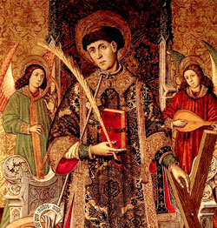
22nd January Memorial of St. Vincent
Deacon and martyr. Born at Huesca, Spain, he became a deacon and served St, Valerius at Saragossa until their martyrdom at Valencia during the persecutions under Emperor Diocletian (r. 284-305).
St. Valerius was exiled, but Vincent was cruelly tortured because he would not surrender the holy books.
He converted the warden of the prison and then died. He was honoured by Sts. Augustine, Pope Leo I, and Prudentius.
He is the patron saint of vinedressers in some regions of Spain.
St. Vincent– Pray for Us

Slide 15
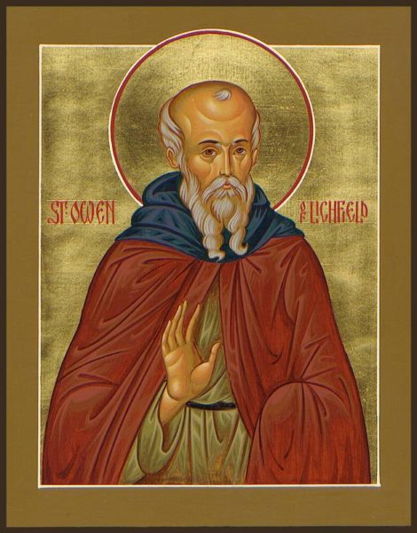
23rd January Memorial in Worcestershire of St. Nicholas Owen
Saint Nicholas Owen, S.J., (c. 1562 – 1/2 March 1606) was a Jesuit lay brother who was the principal builder of priest holes during the reigns of Queen Elizabeth I and James I of England.
After his final arrest, he was tortured to death by prison authorities in the Tower of London.
He is honoured as a martyr by the Catholic Church and was canonised by Pope Paul VI in 1970.
https://en.wikipedia.org/wiki/Nicholas_Owen_(Jesuit)

Slide 16
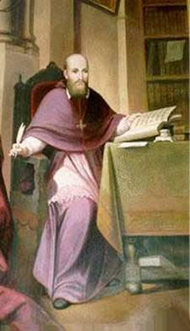
24th January Memorial of St. Francis de Sales, Bishop, Doctor of the Church
His ardent love of God and souls, his great kindliness, rare wisdom and sure teaching made St. Francis exceptionally influential in bringing about conversions and in guiding souls in the spiritual life.
He won back to the faith more than 70,000 heretics, thus restoring to the Church.
He is the author of Treatise on the Love of God and Introduction to the Devout Life. St. Francis died at Lyons in 1622.
St. Francis de Sales… Pray for us.

Slide 17
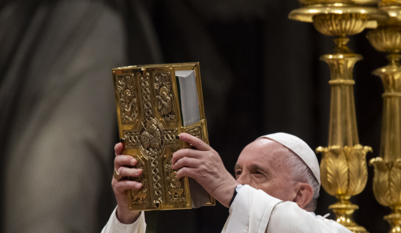
Sunday 22nd Sunday of the Word of God ‘New day instituted by Pope Francis’
Recalling the importance given by the Second Vatican Council to rediscovering Sacred Scripture for the life of the Church, Pope Francis says he wrote this Apostolic Letter in response to requests from the faithful around the world to celebrate a Sunday of the Word of God.

Slide 18
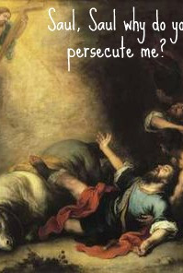
25th January Feast of the Conversion of St. Paul
St. Paul a Jew of the tribe of Benjamin, was born at Tarsus, the capitol of Cilicia. He was a Roman citizen.
He was brought up as a strict Jew, and later became a violent persecutor of the Christians.
While on his way to Damascus to make new arrests of Christians, he was suddenly converted by a miraculous apparition of Our Lord.
From a fierce persecutor he became the great Apostle of the Gentiles.
St. Paul…Pray for us.

Slide 19
26th January Memorial of Ss Timothy and Titus
Saints Timothy and Titus were close companions of the Apostle Paul and bishops of the Catholic Church in its earliest days.
Both men received letters from St. Paul, which are included in the New Testament.
Ancient sources state that St. Timothy followed his mentor in dying as a martyr for the faith. In the year 93, during his leadership of the Church in Ephesus, he took a stand against the worship of idols and was consequently killed by a mob.
Titus is credited with leading the Church of Crete well into his 90s, overturning paganism and promoting the faith through his prayers and preaching. Unlike St. Timothy, St. Titus was not martyred, but died peacefully in old age.
Click the link below to discover more:
https://www.youtube.com/watch?v=Sq1j7PmTR1A

Slide 20
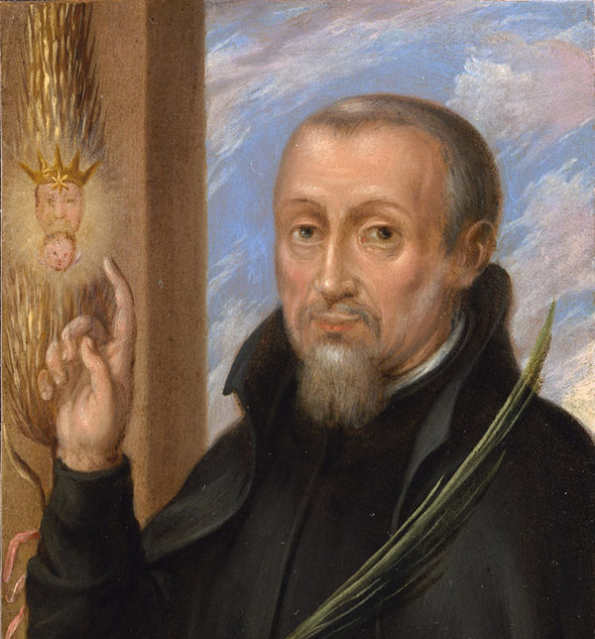
27th January Memorial of Blessed Edward Oldcorne
Blessed Edward Oldcorne was born in York in 1661. He left England to study in France and also went to college in Rome to train to be a priest.
In 1588 he risked his life by returning to England with a small group of other priests. They spent their first night hiding in a wood.
He risked his life many times by venturing out of hiding places to speak to people and bring them back to the Catholic faith.
He was eventually caught, charged with treason and accused of being involved in the gunpowder plot.
He was executed at Red Hill on April 7th 1606.
Blessed Edward Oldcorne… Pray for us.

Slide 21
28th January Memorial of St Thomas Aquinas, Priest, Doctor of the Church Saint Thomas Aquinas Biography. Saint, Theologian, Priest (c. 1225–1274) Italian Dominican theologian Saint Thomas Aquinas was one of the most influential medieval thinkers of Scholasticism and the father of the Thomistic school of theology. Philosopher and theologian.

Slide 22
31st January Memorial of St. John Bosco (Patron Saint of school children)
John Bosco (16 August 1815– 31 January 1888), popularly known as Don Bosco was an Italian Roman Catholic priest, educator, and writer of the 19th century.
While working in Turin, where the population suffered many of the ill-effects of industrialization and urbanization, he dedicated his life to the betterment and education of street children, juvenile delinquents, and other disadvantaged youth.
He developed teaching methods based on love rather than punishment, a method that became known as the Salesian Preventive System.
St. John Bosco…
Pray for us.

Slide 23
Pope’s Prayer Intention February 2023
Universal Intention:
For parishes
We pray that parishes, placing communion at the centre, may increasingly become communities of faith, fraternity and welcome towards those most in need.

Slide 24
2nd February Feast of the Presentation of the Lord

Slide 25
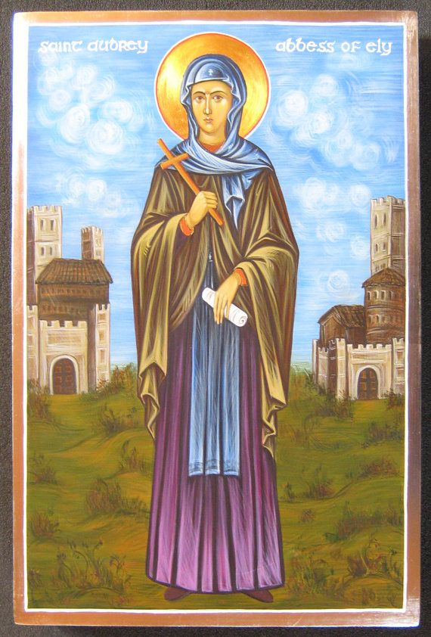
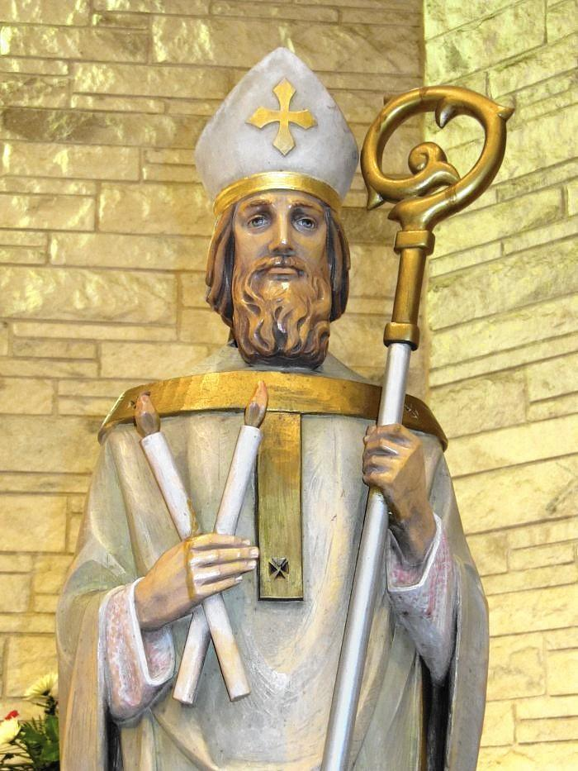
St. Werburgh was born in 650AD in Staffordshire. She was an Anglo-Saxon princess who became the Abbess of many monasteries Trentham and Hanbury, in Staffordshire, and Weedon, in Northamptonshire. She the patron saint of the city of Chester in Cheshire.
3rd February
St. Werburgh, Abbess
St. Blaise, Bishop, Martyr
He was an early Christian bishop and martyr, one of the most popular medieval saints.
While imprisoned by the roman Emperor, he miraculously cured a boy from fatally choking.
He was executed and died in 316AD.
He is venerated as the patron saint of sufferers from throat diseases and of wool combers and as one of the Fourteen Holy Helpers.
St. Werburgh…Pray for us.
St. Blaise…Pray for us.

Slide 26
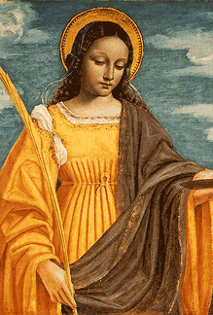
5th February Memorial of St. Agatha, Virgin, Martyr
According to Maltese tradition, during the persecution of Roman Emperor Decius (AD 249–251), Agatha, together with some of her friends, fled from Sicily, and took refuge in Malta.
Some historians believe that her stay on the island was rather short, and she spent her days in a rock hewn crypt at Rabat, praying and teaching the Christian Faith to children.
After some time, Agatha returned to Sicily, where she faced martyrdom. Agatha was arrested and brought before Quinta and she was imprisoned and died.
St. Agatha… Pray for us.

Slide 27
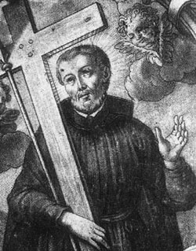
6th February Memorial of St Paul Miki, Martyr
Paul was born in Japan and was the of a Japanese military leader.
He was educated at the Jesuit college of Anziquiama, joined the Jesuits in 1580, and became known for his eloquent preaching.
He was crucified on February 5 with twenty-five other Catholics during the persecution of Christians under the Taiko, Toyotomi Hideyoshi, ruler of Japan in the name of the emperor.
St. Paul Miki – Pray for Us

Slide 28
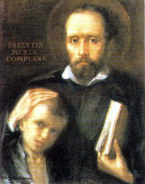
8th February
Memorial of St. Jerome Emiliani
St. Jerome Emiliani was born in 1481 and died in 1537 He was a military commander for Venice in charge of a fortress.
After a short time as mayor of Treviso he returned home to Venice where he studied for the priesthood.
He felt a special call to help the orphans who had no one to care for them.
He founded orphanages in other cities, a hospital, and a shelter for the poor.
Let us Pray.
Saint Jerome Emiliani, watch over all children who are abandoned or unloved. Give us the courage to show them God's love through our care. Help us to lose the chains that keep us from living the life God intended for us.
Amen
St. Jerome … Pray for us.

Slide 29
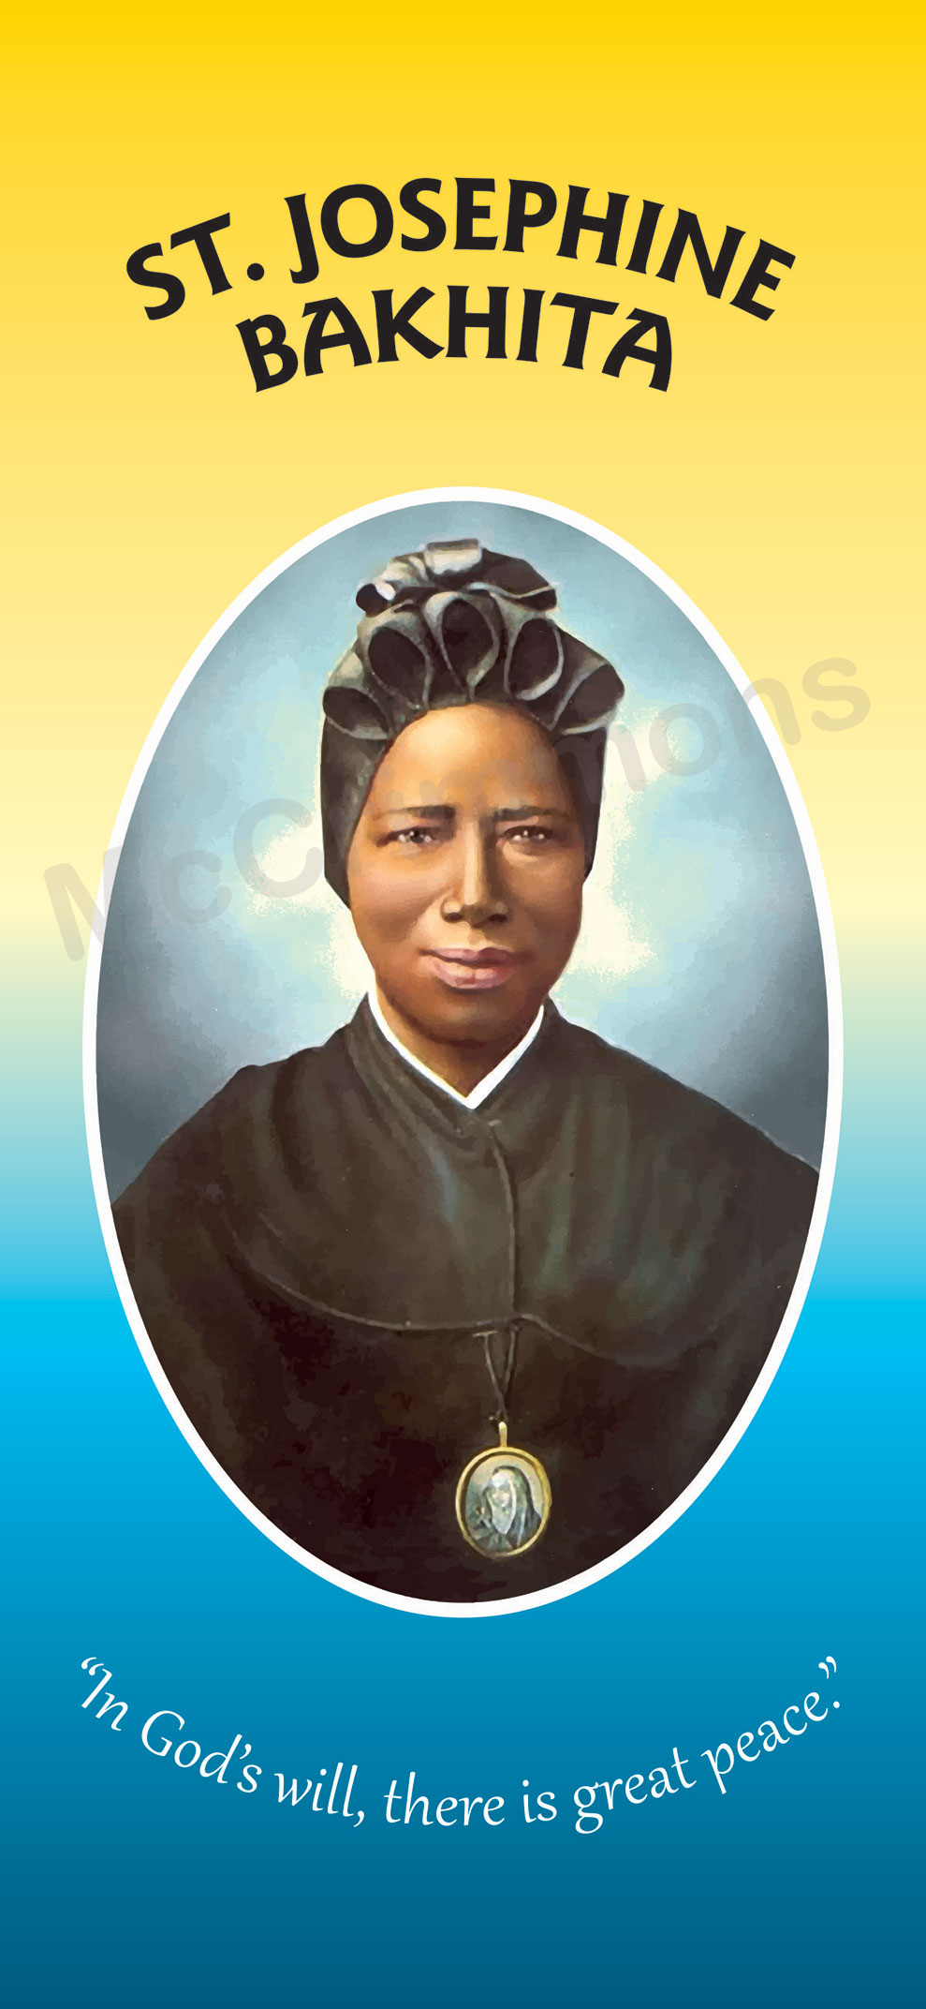
8th February
Memorial of St Josephine Bakhita
Saint Josephine Bakhita was born in Sudan, Africa around1869.
Her early childhood was a happy one. However, when she was seven, she was kidnapped by slave traders!
From then on she was called Bakhita, meaning “lucky.” She was sold many times during the next twelve years.
On December 7, 1893 she entered the Canossian Daughters of Charity and made her final vows on December 8, 1896.
During the following forty-two years, she served as a cook and a doorkeeper.
Sometimes, she travelled to other convents telling her story and preparing the sisters for mission work in Africa.
“The Lord has loved me so much: we must love everyone; we must be compassionate!”
Saint Josephine Bakhita… pray for us!

Slide 30
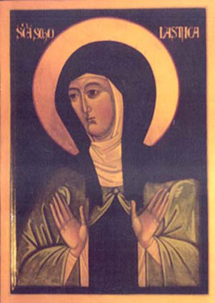
10th February Memorial of St Scholastica, Virgin
Scholastica (c. 480 – 10 February 543) is a saint of the Catholic Church and the Eastern Orthodox Churches.
She is honoured in the Episcopal Church's calendar of saints. She was born in Italy.
According to a ninth century tradition, she was the twin sister of Benedict of Nursia.
Her feast day is 10 February.

Slide 31
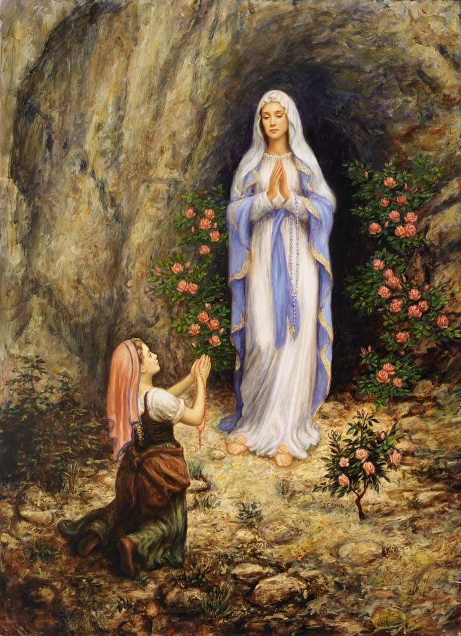
11th February Memorial of Our Lady of Lourdes.
Our Lady of Lourdes is a Roman Catholic title of the Blessed Virgin Mary venerated in honour of the Marian apparitions that occurred in 1858 in the vicinity of Lourdes in France.
The first of these is the apparition of 11 February 1858, when 14-year old Bernadette Soubirous told her mother that a "lady" spoke to her in the cave of Massabielle.
Our Lady of Lourdes…
Pray for us.

Slide 32
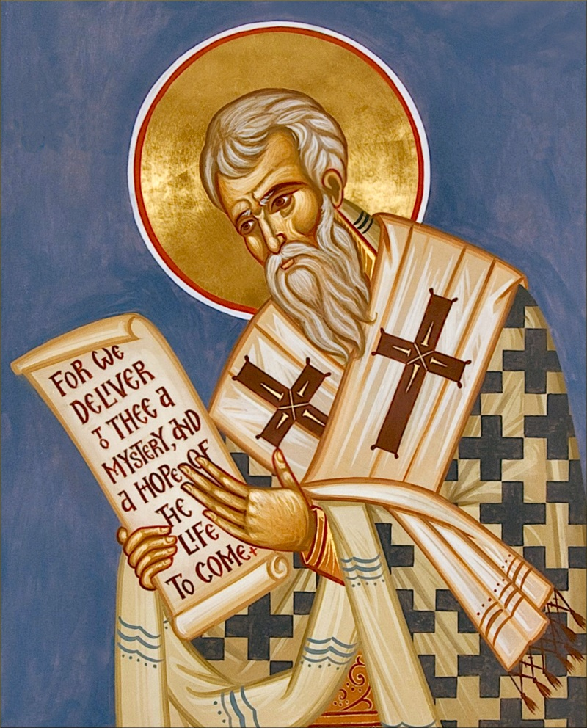
14th February Feast of St Cyril, Monk
Saint Cyril (aka Kyrillos and Constantine the Philosopher, d. 867 CE) was a Byzantine linguist, teacher, scholar and missionary who famously preached Christianity to the Slavs in Moravia with his brother Methodius during the 9th century CE.
He created the Glagolitic alphabet, the forerunner to the Cyrillic alphabet that bears his name, and did much to spread the religion, art and culture of the Byzantine empire into central Europe.
St. Cyril… Pray for us.

